Slide 1
DataStax Enterprise Solution Day

Slide 2
Agenda

Slide 3
DSE Graph
Product Overview
Notes:
Now I’d like to show you Cassandra in action and what that experience is like, working with CQL in DataStax Enterprise

Slide 4
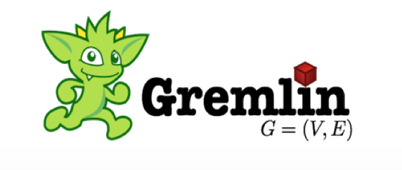
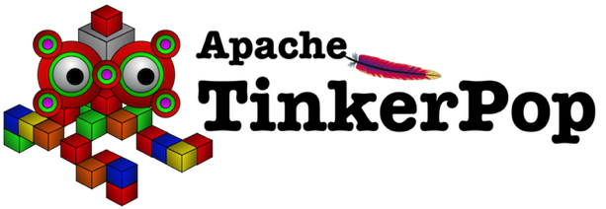
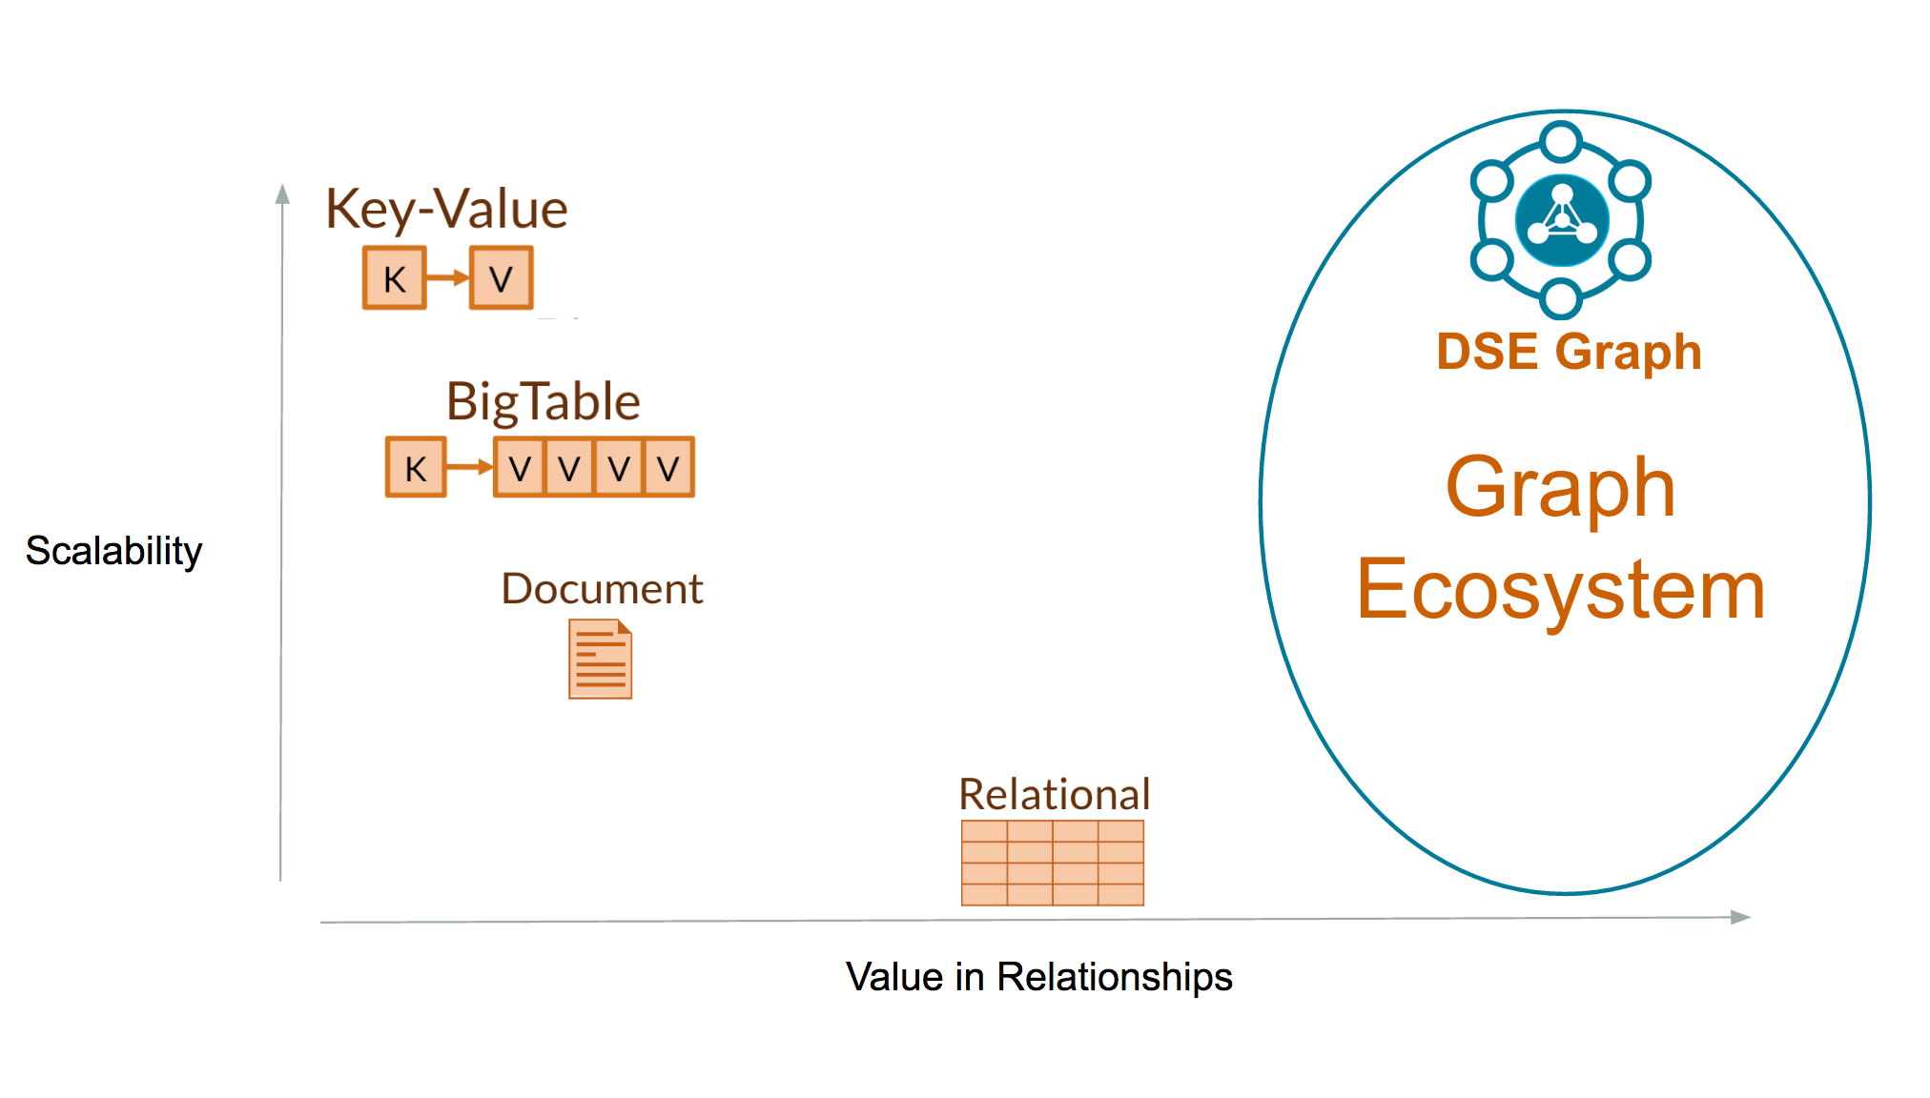
Dse Graph
A scalable, distributed graph database optimized for storing, traversing, and querying complex graph data in real- time
Value data between relationships
DSE Analytics and Search integrated
Perfect for use cases:
Customer 360
Recommendations
Fraud Detection
Notes:
We are really excited about these performance improvements because of what they mean for you – with twice the read/write throughput, you can run the same workloads on less hardware
It’s not just about performance, we’re also making major gains in operational simplicity and developer productivity
We’re making it easier for operators to run DSE with features like NodeSync
We’re making it easier for developers to create applications and interact with data through improvements in our drivers and DataStax Studio

Slide 5






Getting Started
Graph databases are useful for discovering simple and complex relationships between objects. Relationships are fundamental to how objects interact with one another and their environment. Graph databases are the perfect representation of the relationships between objects
Who are our most influential customers?
What are all the ways a customer is interacting with our company?
How much better could we achieve our company goals if we understood the complete view of our customers.
has
TAG
rated
located
resides
CUSTOMER
COUNTRY
Purchase
PRODUCT
located
Contains
ADDRESS
Ships to
STREET
ORDER

Slide 6

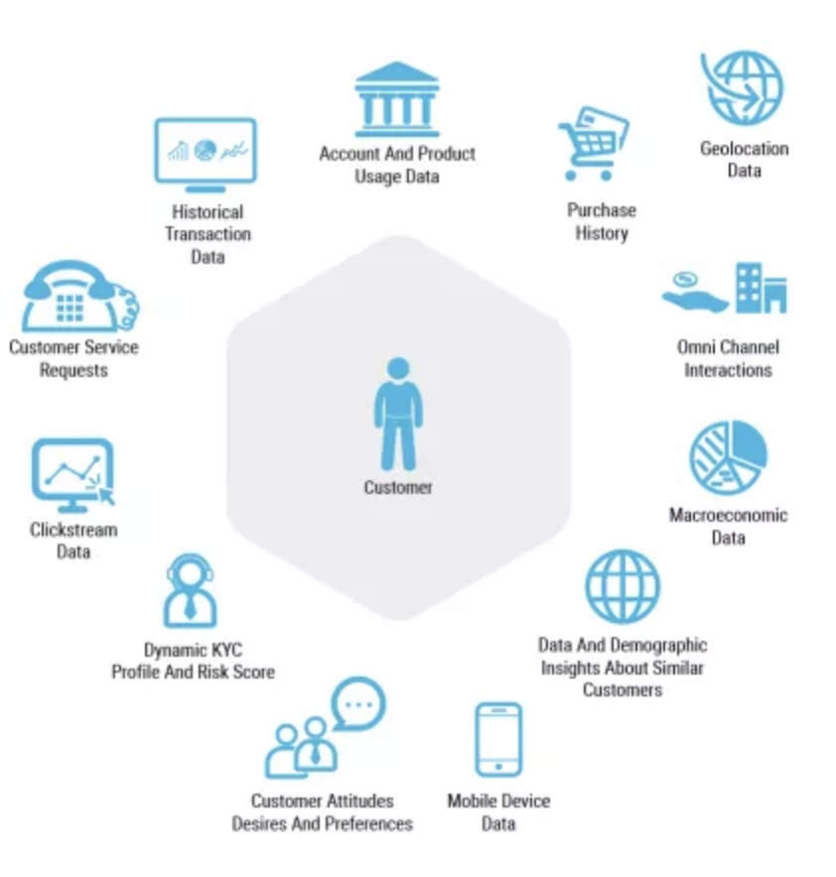
Customer 360
Gain a singular, contextual view of the customer in real time for a seamless, personalized customer experience across all touchpoints.
Companies want to have a complete view of their users or products. Understanding every interaction and touchpoint across multiple business units is key to a great customer experience. A graph model is the best way to consolidate and make sense of data from disparate sources such as customer facing apps and business backend systems.

Slide 7

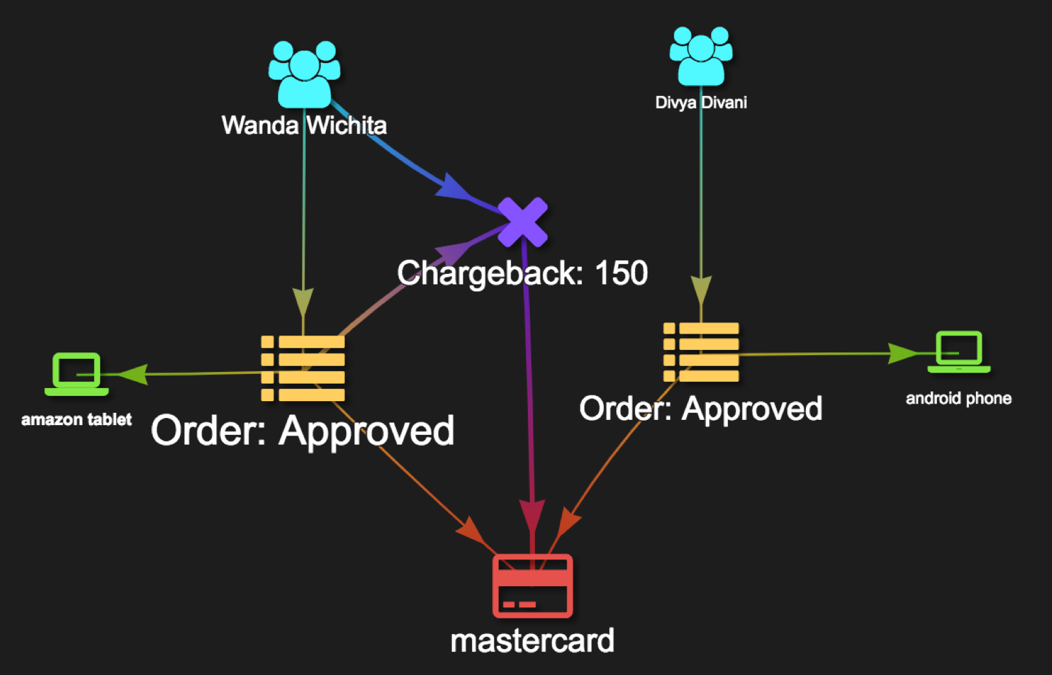
Fraud Detection
A graph database helps connect the dots to identify trends while at the same time spot outliers as potential threats.
Will be the subject of
TODAY HANDS-ON !!!

Slide 8

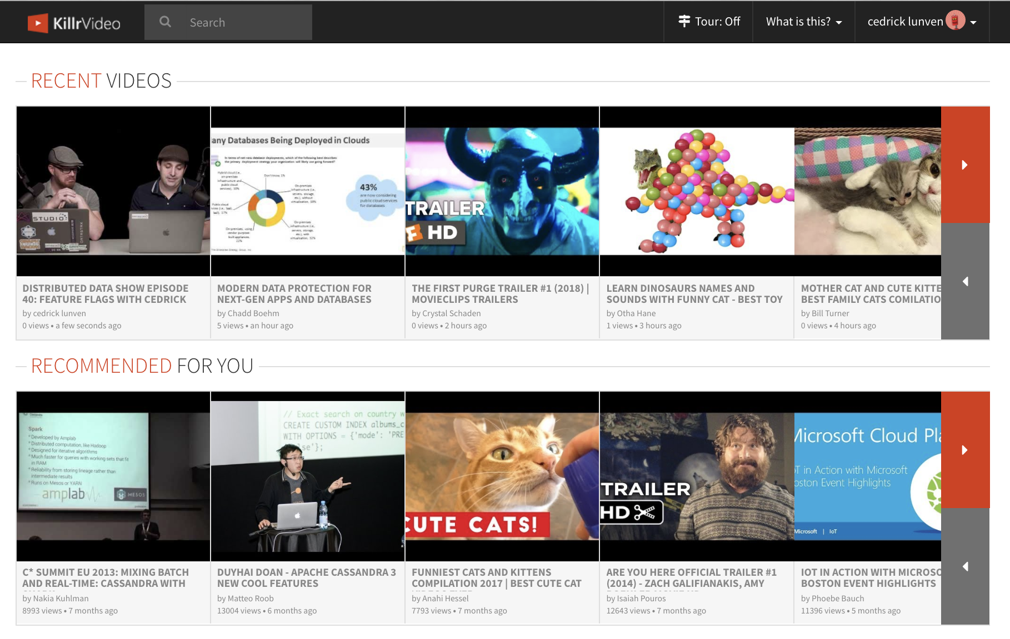
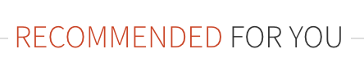
Personalization & Recommendation
What are the videos people with same interests (tags) as me have liked the most ?
A graph database is the most efficient tool for understanding users and creating insightful, data-driven, real-time experiences.
These actions must be based on the most recent actions and operate in real time to deliver a highly relevant customer experience.

Slide 9

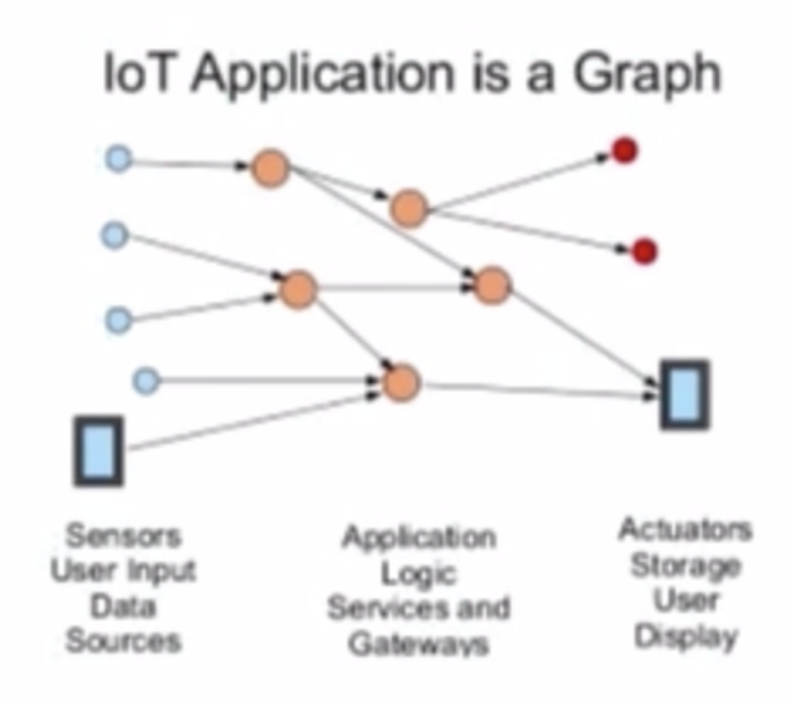
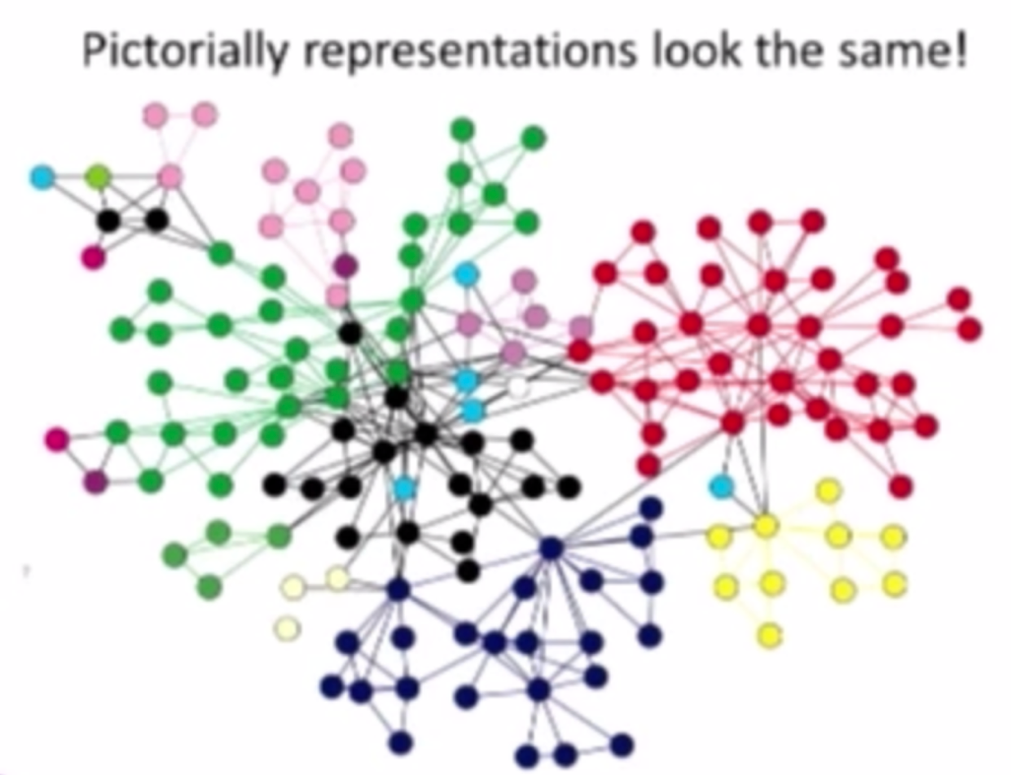
IoT, Asset management & Networking
How easily perform analysis on numerous relationships that form among data elements and tend to be of much greater interest when examined collectively than reviewed in isolation ?A graph is also a good model for managing network assets (with their properties or configurations) and how they related to each other over time.
https://www.bigdatapaper.com/2016/05/25/iot-where-do-graphs-fit-with-business-requirements

Slide 10

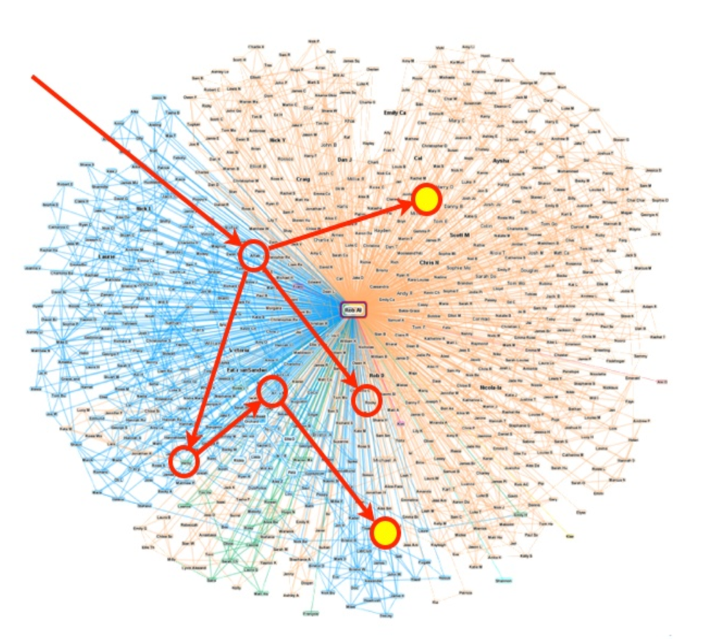
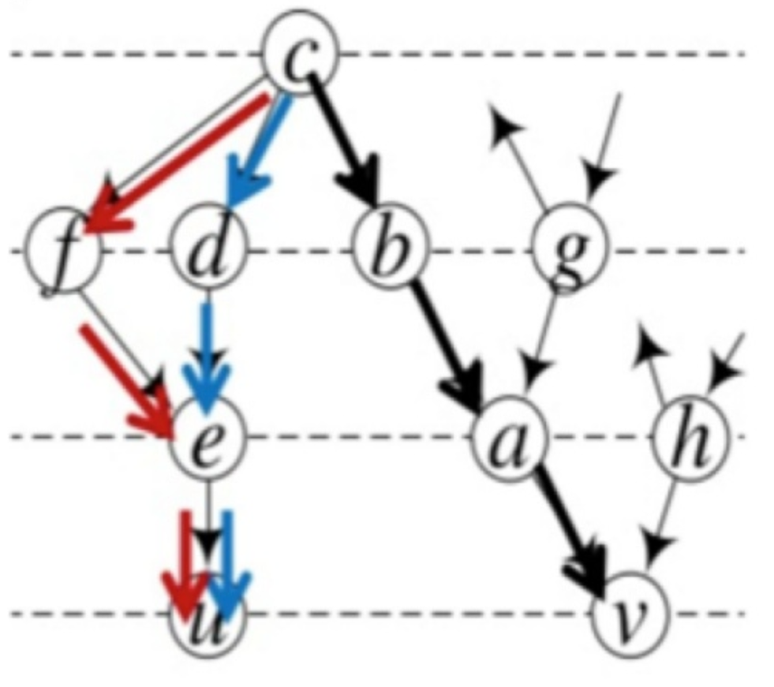
Others use cases…
Healthcare
What drugs bill bind to proteinX
and interact with drug Y
Path Finding
What manufacturing lines lead
to the most defects.
Social
How people are connected.
Who is more influential.

Slide 11
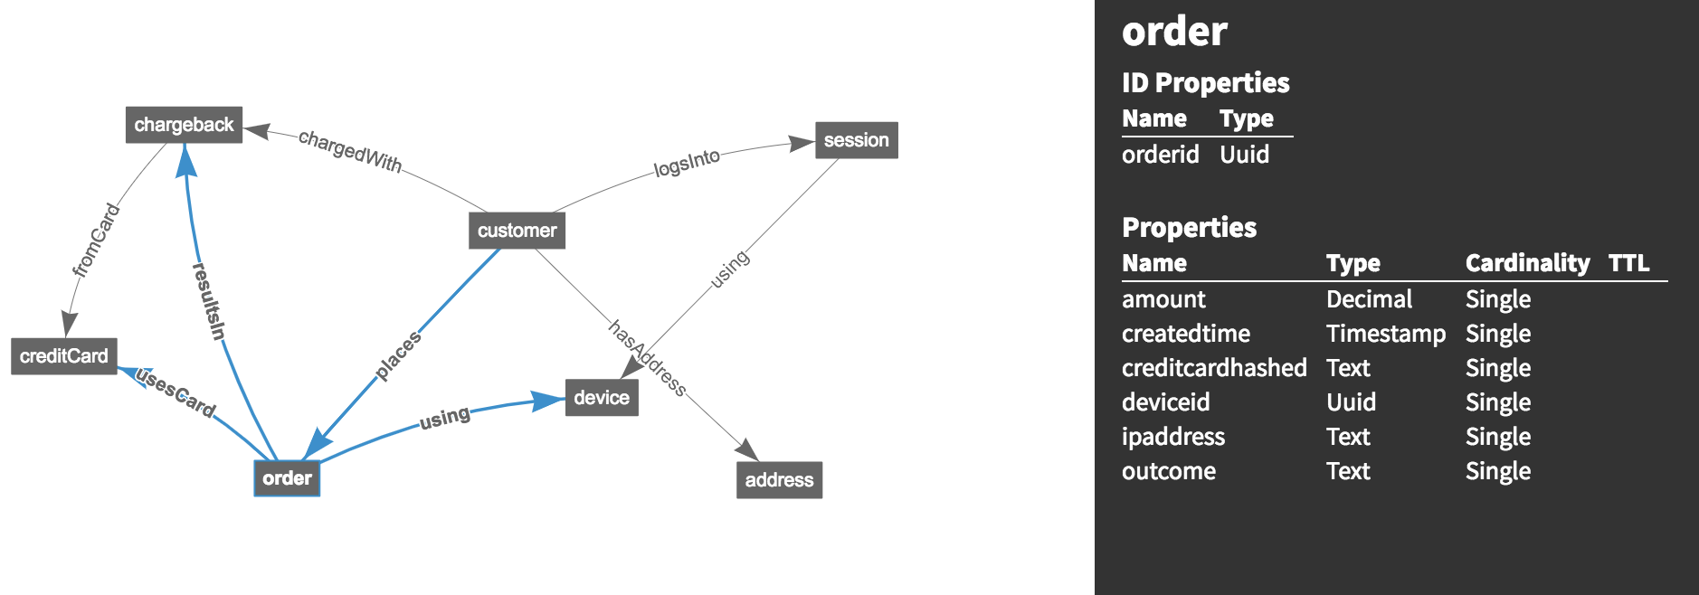
Vertex
A vertex is an noun, such as a person, location, customer, order or anything else you can think of as nouns.
label

Slide 12
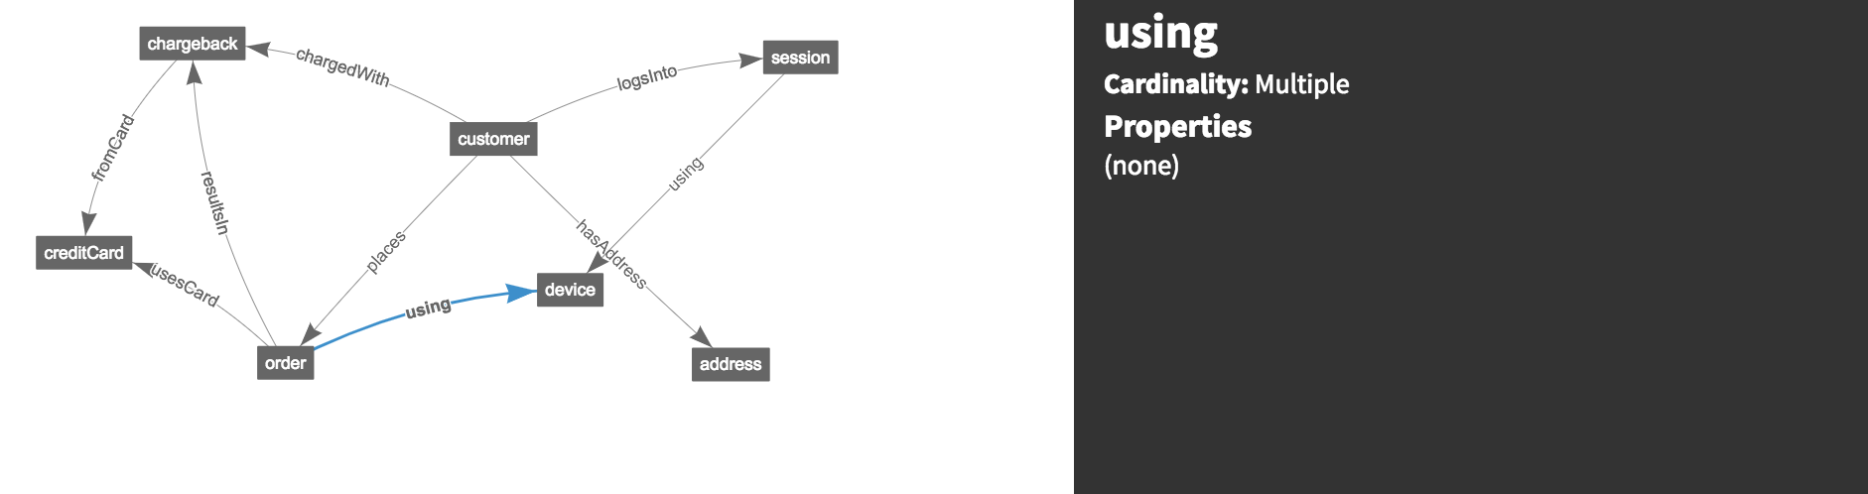
Edge
An edge defines the relationship between two vertices, it is a verb. A person can create software, or an author can write a book. Think verbs when you are defining edges.

Slide 13
Property
A property store information for a vertex, edge or another property. Property have unique name, a type and a cardinality.
Information in a graph database can be retrieved using graph traversals. Graph traversals “walk” a graph with a single or series of traversal steps that can define a starting point for a traversal and filter the results to find the answers to queries about the graph data.
schema.propertyKey('customerid').Uuid()
.ifNotExists().create()
schema.propertyKey('firstname').Text()
.ifNotExists().create()
schema.propertyKey('amount').Decimal()
.ifNotExists().create()
g.V().hasLabel("product")
.has("title",textContains("Fan")) .inE("reviewed") .has("score",5) .values("summary")

Slide 14
Playground
Name: Lisa
Age : 32
Find Lisa’s order numbers.
14
1
Number: 1234
16
g.V()
ordered
.has('customer',
'name’, 'Lisa’)
15
related
2
CUSTOMER
type : friend
.out('ordered’)
11
13
Name: Frank
Age : 28
.values('number')
purchased
12
ships
quantity: 1
ORDER
date: 1/2/2016
17
4
name: socks
size: XL
resides
5
since: 1/1/2000
CUSTOMER
18
purchased
has
PRODUCT
quantity: 42
valid: 1/2/2012
Street : 123 West Street
zipcode: 44534
6
ADDRESS
name: shirt
size: XL
PRODUCT
19
Type : color
value: white
TAG
has
valid: 1/2/2012

Slide 15
Playground
Find all product names purchased by Frank’s friends.
Name: Lisa
Age : 32
g.V()
.has('customer',
'name’, ‘Frank’)
1
Number: 1234
14
16
.outE(‘related’)
.has(‘type’, ’friend’)
ordered
.inV()
15
related
2
CUSTOMER
type : friend
11
13
.out('ordered’)
Name: Frank
Age : 28
purchased
12
ships
.out(’purchased’)
quantity: 1
ORDER
date: 1/2/2016
17
4
.values(‘name')
name: socks
size: XL
resides
5
since: 1/1/2000
CUSTOMER
18
purchased
has
PRODUCT
quantity: 42
valid: 1/2/2012
Street : 123 West Street
zipcode: 44534
6
ADDRESS
name: shirt
size: XL
PRODUCT
19
Type : color
value: white
TAG
has
valid: 1/2/2012

Slide 16
Agenda

Slide 17
Thank you

